Slide 1
NASCAR Esports

Slide 2
Outline
eNASCAR is setting records for esports events. How can our data help answer these questions:
How many of these viewers are NEW to NASCAR (i.e. incremental to the NASCAR base)?
Are they younger?
Do they also play NASCAR games online?
What percentage of them will watch actual NASCAR?

Slide 3
Q: How many of these viewers are NEW to NASCAR (i.e. incremental to the NASCAR base)?
A: Nielsen is in the pole position when it comes to measuring TV viewership, but they lack Datalucent’s granularity. Because our data iterates over time, we know when individuals interact with eNASCAR/NASCAR content, which individuals were fans previously, and which ones have just become fans. We can also see other places where audience growth is occurring. In this example, Mark went from not being a NASCAR fan, to being an eNASCAR fan, to then becoming a full NASCAR fan:
Not a fan
New Fan
Full Fan
Time
Mark
eNASCAR Esports Game
“Garrett Smithley was streaming his
in-car on his Twitch account and he had nearly 4,000 viewers, according to the viewership number posted. His previous largest viewership numbers
was in practice races the day prior and it was 350 viewers.”
Follows Twitter Account
Subscribes
Purchases
eNASCAR Twitch Channel
NASCAR
on Fox Sports 1
Notes:
* Source: https://www.foxsports.com/nascar/story/enascar-iracing-pro-invitational-homestead-miami-speedway-denny-hamlin-dale-earnhardt-jr-032220#

Slide 4
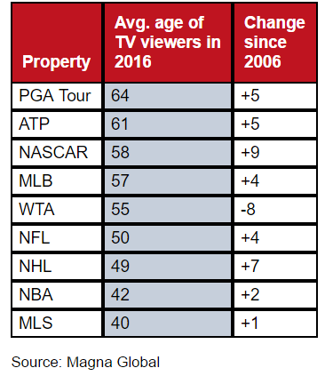
Q: Are they younger?
A: Given that Facebook and Twitter both provide information about age, we already know how old our panelists are. Since the average age of NASCAR fans is known, we could create an “eNASCAR” panel and measure if eNASCAR fan were younger than traditional NASCAR fans.
(Spoiler: they definitely are.)

Slide 5



Q: Do they also play NASCAR games online?
A: We can learn this several ways. YouTube and Twitch could reveal the amount of eNASCAR esports content that is being consumed, which could be used as a proxy for ownership of NASCAR games. A more robust approach would be to integrate Steam API data into Datalucent’s pipeline. Example:
Mark
eNASCAR Esports Game
API Integration
Consensual Access
Consensual Access
Subscribes
Purchases
Mark
NASCAR Twitter

Slide 6
Q: What percentage of them will watch actual NASCAR?
A: Previously one would need to combine Nielsen style TV viewership data with social data to know the answer. But, because Datalucent iterates over time, we can estimate this without linear data:
Group A
Followed NASCAR on Twitter first, then followed eNASCAR on Twitter Second
From this example, we can see that 28% of individuals tracked were first interested in eNASCAR before becoming interested in real-life NASCAR. This suggests that individuals in this group are new real-life NASCAR fans.
Group B
Followed eNASCAR on Twitter first, then followed NASCAR on Twitter Second
Group C
Only follows NASCAR or eNASCAR on Twitter, but not both

Slide 7
The Fluid Fan Changes Over time
Analyzing information that iterates over time is key to understanding evolution of the fluid fan. Nielsen attempts to combine social listening data with traditional linear TV metrics to reveal insights but their lack of granularity on individuals’ behavior limits its usefulness as a marketing tool.
The quote on the right illustrates nicely just how little they actually know about whether or not esports is helping NASCAR. They already pay for Nielsen… so clearly there is not good data on this subject for them!
“If we got five new fans that were just sitting at home watching TV today that thought it was exciting and is willing to tune in next week or willing to tune in to a NASCAR race or go to a NASCAR race because they got introduced to racing today by iRacing, it’s a success. … If you made positive gains in your audience, whether it be one person or 1,000, it’s a good thing.”

